Slide 1
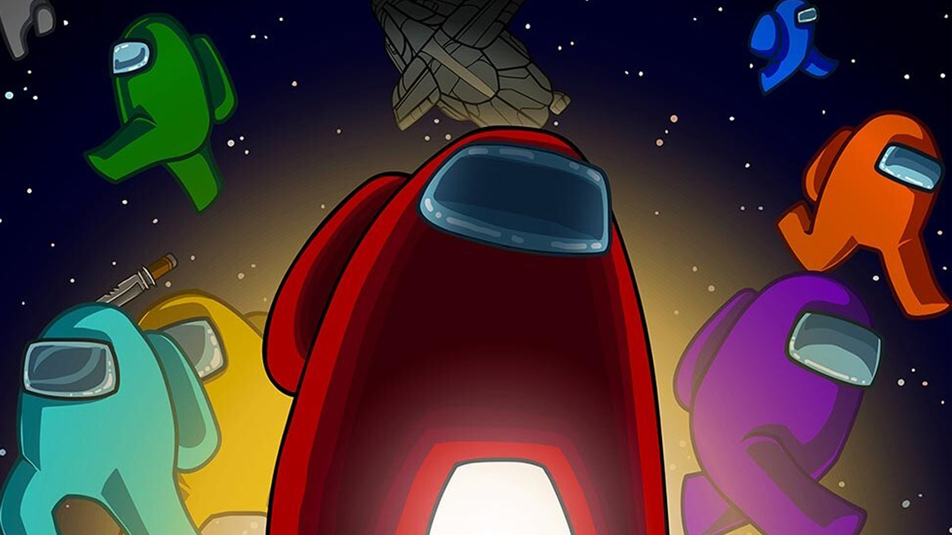
Among Us
Presented by:
Katrin Tarneva, Neyko Neykov, Kristian Savov, Kristian Kolev

Slide 2
Content
About the game
Supposed user
User requirements
Gameplay
Survey results
Interviews
Personas

Slide 3
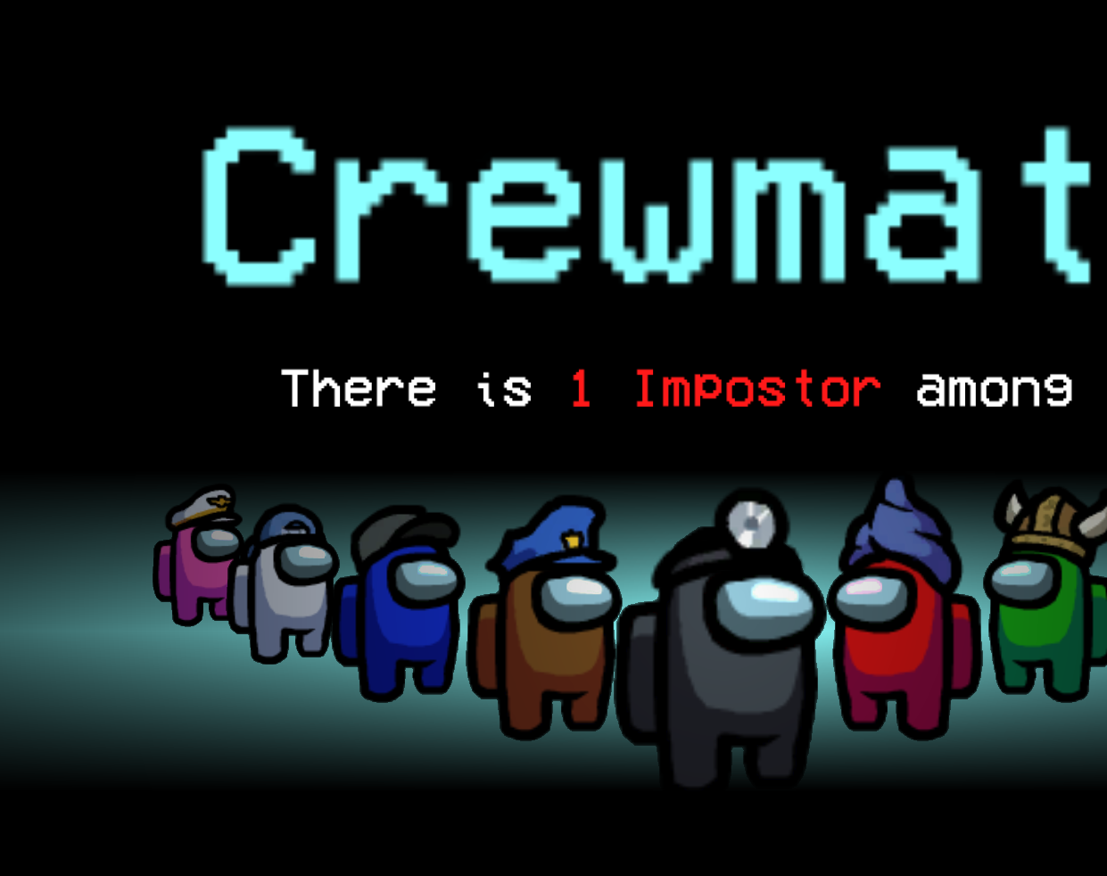
About the game
Online multiplayer game
Genre: Social deduction game
Released in 2018 but became popular in 2020
Available on Android, iOS, and PC,also a cross platform
Gained most of its popularity through out YouTubers and Streamers

Slide 4
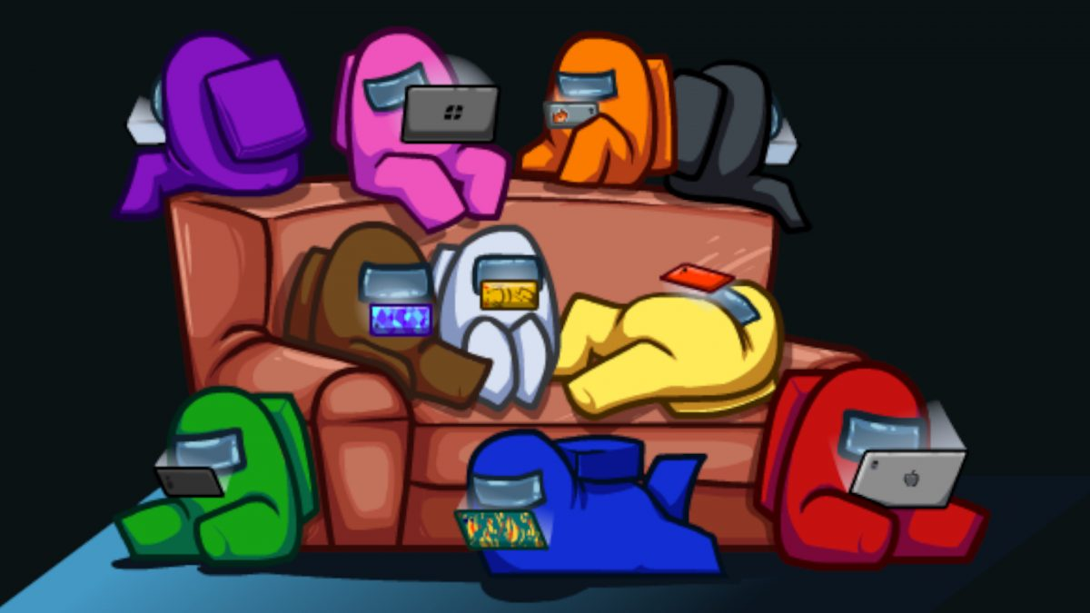
Supposed user
This game is created for every gender
This game is created to be played by teenagers
The user doesn’t need the best computer in the world, Among Us developers made the game extremely light and easy to run on almost every computer.

Slide 5
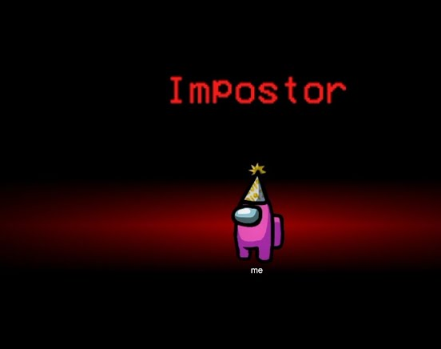
User requirements
Interesting gameplay
Fun to play
Relaxing
Good graphics
Easy to run on your computer
Reasonable pricing

Slide 6
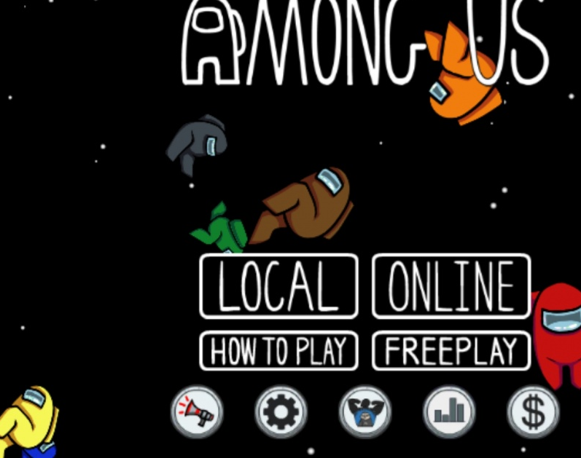
Gameplay
Crewmates
Impostors
Crewmates have Tasks
Impostors have fake tasks
If every crewmate completes his/hers tasks they win or if they vote out the impostors
If the impostor/s manage to kill everyone or convince others that they are innocent impostor/s win.

Slide 7
Survey Results

Slide 8
Survey Results

Slide 9
Survey Results

Slide 10
Survey Results

Slide 11
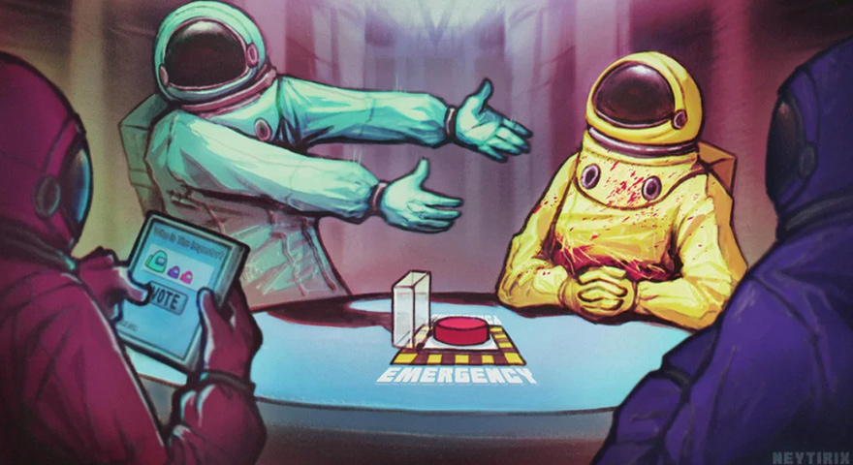
Interviews

Slide 12


Interviewer: Katrin…

Slide 13
Interviewer: Kristian…

Slide 14
Interviewer: Neyko…

Slide 15
Personas

Slide 16
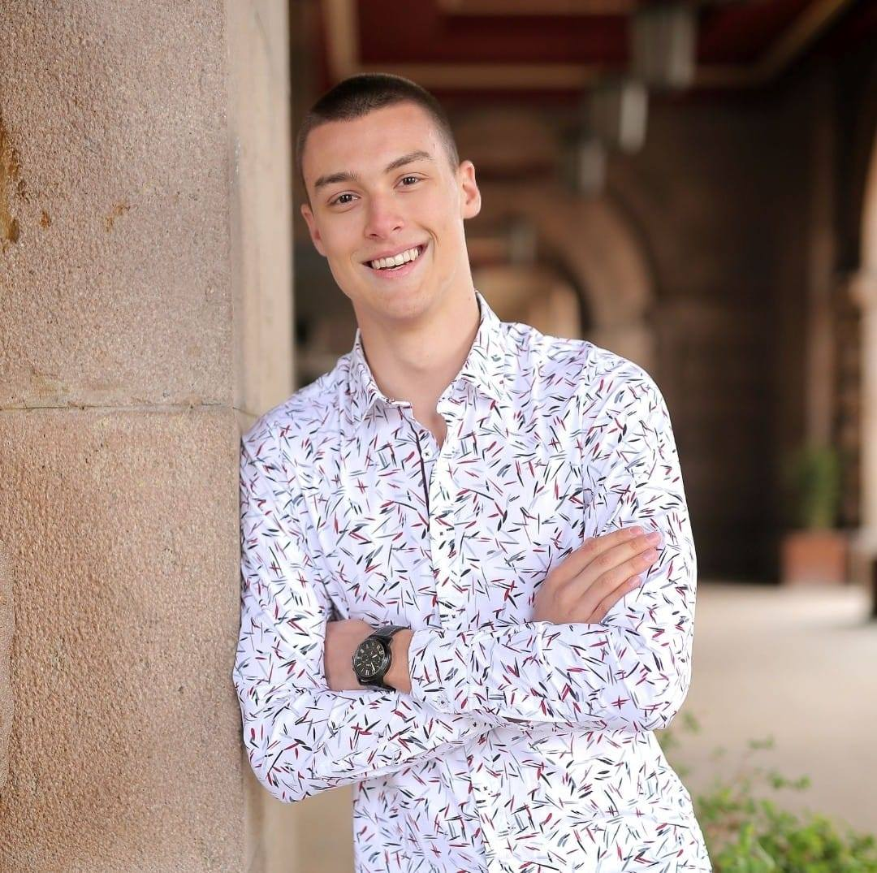
Todor Ranchev
Age: 20
Occupation: IT Student
Location: Surrey
A bit about him: One of his goals is to graduate from university and return to Bulgaria as a JavaScript developer. His hobbies are mostly involved around the IT field but he enjoys playing video games in his free time.
He prefers PC as a platform for games and his favorite genre is first-person shooter games. The time he spends playing games is around 2-3 hours a day.
On top of that he doesn’t mind supporting the creator of a certain video game if he enjoys the gameplay and overall content. That is why he owns Among Us and is currently spending his free time playing the game with his friends.

Slide 17

Jonathan Bobbins
Age: 28
Occupation: Doctor
Location: London
A bit about him: He became doctor in 2017 and he is currently working towards his goal to becoming one of the most renowned doctors in his field. Because of his job he doesn’t have time to play video games anymore.
He prefers PS4 as a platform for gaming and the genre that he enjoys the most is turn-based games.
He never played Among Us but he knows about the game through his colleagues.

